Slide 1
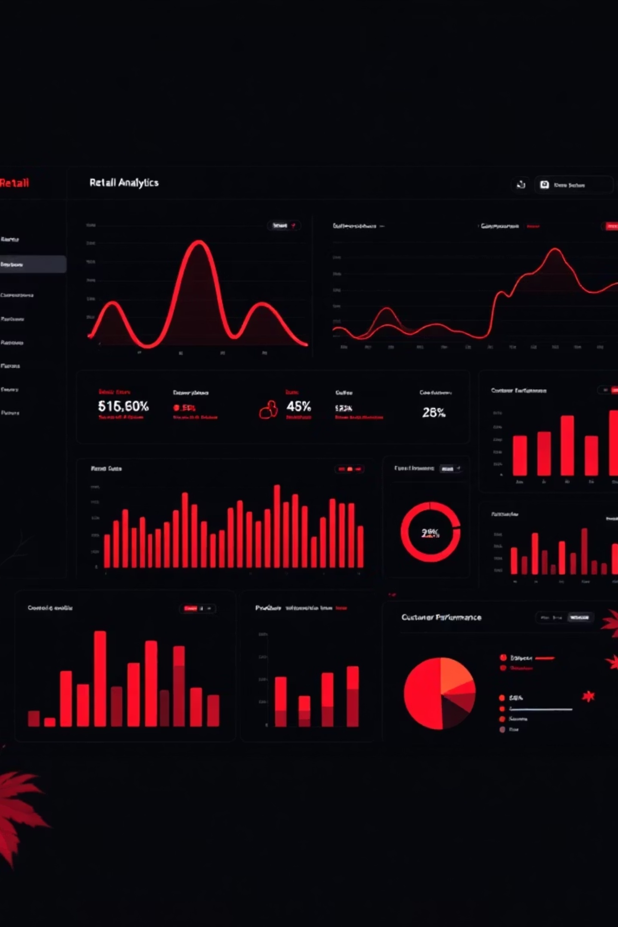
Shopping Analysis of Customers
Final Project Report
A comprehensive end-to-end analytics project leveraging Python, PostgreSQL, and Power BI to uncover actionable insights from customer shopping behavior and drive strategic business decisions.

Slide 2

Business Challenge & Opportunity
The Problem
Core Question
A leading retail company observed significant shifts in purchasing patterns across demographics, product categories, and sales channels. Management needed deeper insights into what drives customer decisions and repeat purchases to optimize marketing strategies and improve customer lifetime value.
How can we leverage consumer shopping data to identify trends, improve customer engagement, and optimize marketing and product strategies across online and offline channels?
Key factors examined: discounts, reviews, seasonality, payment preferences, and demographic patterns.

Slide 3
Project Approach & Deliverables
01
02
Data Preparation
Data Analysis
Clean and transform raw dataset using Python (Jupyter Notebook) to ensure data quality and create derived features for analysis.
Structure data in PostgreSQL, simulate transactions, and extract insights about customer segments, loyalty drivers, and purchase behavior.
03
04
Visualization
Insights & Recommendations
Build interactive Power BI dashboard to highlight key patterns and trends for stakeholder decision-making.
Deliver actionable business recommendations through comprehensive report and presentation materials.
All project materials, including Python scripts, SQL queries, and dashboard files, are hosted in a well-structured GitHub repository for reproducibility and collaboration.

Slide 4
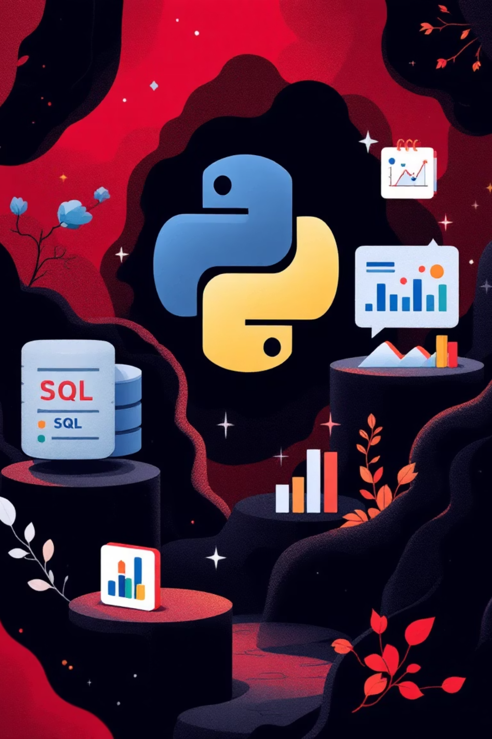
Dataset Overview & Technical Foundation
Dataset Profile
Technology Stack
Records: ~3,900 customer transactions
Columns: 18 data attributes
Python (Jupyter): Data cleaning & preprocessing
Categories: Customer details, transaction data, behavior metrics
PostgreSQL: Data modeling & business queries
Quality: 37 missing ratings imputed using category-level medians
Power BI: Dashboard visualization
Key Data Elements
Excel: Validation & exports
Customer details: customer_id, age, gender, location, subscription_status
SQLAlchemy: Python-to-SQL connectivity
Transaction data: product_name, category, purchase_amount, review_rating, shipping_type
Behavior metrics: discount_applied, previous_purchases, purchase_frequency, season

Slide 5


Data Preparation Excellence
1
Standardization
Renamed inconsistent column names to snake_case format for consistency across the analytical pipeline.
2
Missing Value Treatment
Handled missing values intelligently using category-level medians to preserve data distribution patterns.
3
Feature Engineering
Created derived columns including age_group and purchase_frequency_days to enable segmentation analysis.
4
Data Quality
Removed duplicates and irrelevant columns, then exported cleaned dataset for SQL database upload.
Python Data Pipeline
Comprehensive data cleaning performed in Jupyter Notebook using pandas and NumPy to ensure analysis-ready data quality.
Database connectivity established using SQLAlchemy with psycopg2-binary driver, enabling seamless Python-to-PostgreSQL data transfer with chunking for performance optimization.

Slide 6

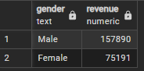
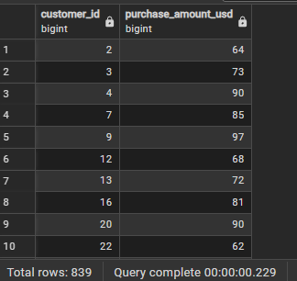
Key Customer Insights
Total Revenue by Gender
High-Spending Discount Users
Customers who availed discounts but spent above the average purchase value show high buying intent despite price sensitivity. These users are valuable deal-seekers — personalized discount offers can help convert them into loyal, repeat buyers.
Male customers generated significantly higher revenue (157,890) compared to females (75,191).
This shows males contribute a larger share to total sales — suggesting room to improve female engagement.
SQL-based exploratory data analysis uncovered critical patterns in customer spending, loyalty behavior, and purchase trends across multiple dimensions including demographics, product categories, and transaction characteristics.

Slide 7
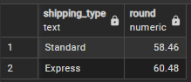
Key Customer Insights
Top 5 Products by Review Rating
Average Purchase by Shipping Type
Express shipping customers spent slightly more on average (₹60.48) than Standard shipping users (₹58.46).
This indicates that premium shipping users are higher-value buyers, and offering express shipping incentives could increase revenue
.
aProducts like Gloves, Sandals, and Boots received the highest average ratings (≈3.8–3.9), showing strong customer satisfaction.
•These items can be featured in promotions or marketing campaigns to attract new customers and reinforce product trust.
SQL-based exploratory data analysis uncovered critical patterns in customer spending, loyalty behavior, and purchase trends across multiple dimensions including demographics, product categories, and transaction characteristics.

Slide 8
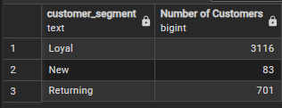
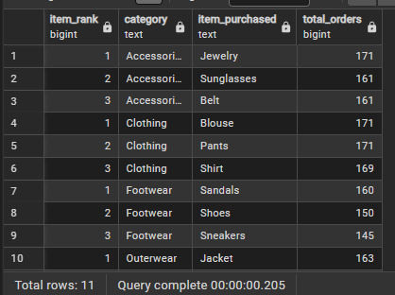
Key Customer Insights
Customer Segmentation By Loyalty
Top 3 Products by Category
Across categories, items like Jewelry, Pants, and Sandals appear among the most purchased, showing consistent demand.
This indicates category concentration, suggesting a focus on cross-selling related products to boost overall sales..
Loyal customers (3,116) form the largest segment and are the main revenue drivers, while new (83) and returning (701) customers are smaller groups.
This highlights the need to retain loyal customers and nurture new ones through personalized engagement strategies.
SQL-based exploratory data analysis uncovered critical patterns in customer spending, loyalty behavior, and purchase trends across multiple dimensions including demographics, product categories, and transaction characteristics.

Slide 9
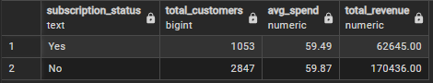
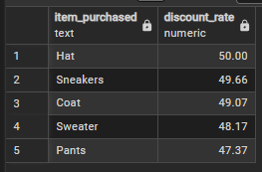
Key Customer Insights
Subscriber Spending Analysis
Top 5 Discounted Products
Products like Hats, Sneakers, and Coats have the highest discount rates (≈47–50%), showing they are frequently promoted to drive sales.
These items likely attract deal-seekers — optimizing discount levels could maintain demand while protecting profit margins.
.
Subscribers, though fewer in number, contribute a higher total revenue (₹62,645) and maintain a strong average spend.
This shows that subscription programs boost customer loyalty and spending consistency — worth expanding further.
SQL-based exploratory data analysis uncovered critical patterns in customer spending, loyalty behavior, and purchase trends across multiple dimensions including demographics, product categories, and transaction characteristics.

Slide 10
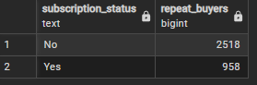
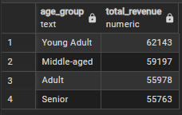
Key Customer Insights
Repeat Buyers vs Subscription
Correlation
Revenue Contribution by Age Group
Young Adults generate the highest revenue (₹62,143), followed by Middle-aged and Adult groups.
This indicates that younger shoppers are the most active buyers, and targeted marketing toward them can further boost sales..
Among repeat buyers, 958 are subscribed while 2,518 are non-subscribed, showing a partial but positive correlation.
Encouraging frequent buyers to subscribe can strengthen loyalty and increase long-term retention.
SQL-based exploratory data analysis uncovered critical patterns in customer spending, loyalty behavior, and purchase trends across multiple dimensions including demographics, product categories, and transaction characteristics.

Slide 11
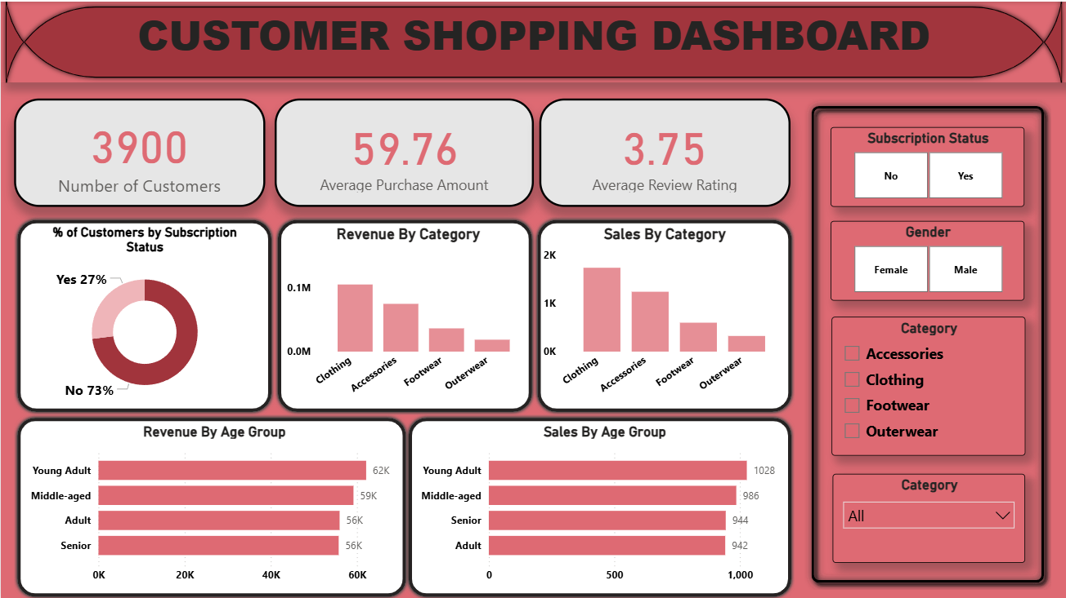
Dashboard
Loyal

Slide 12
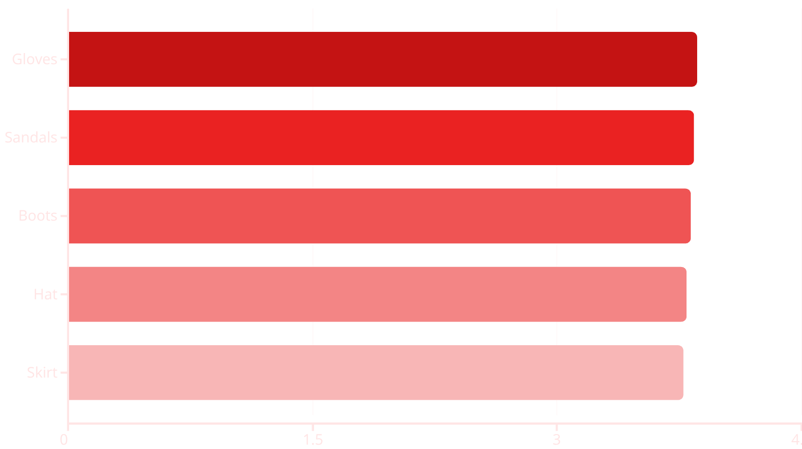
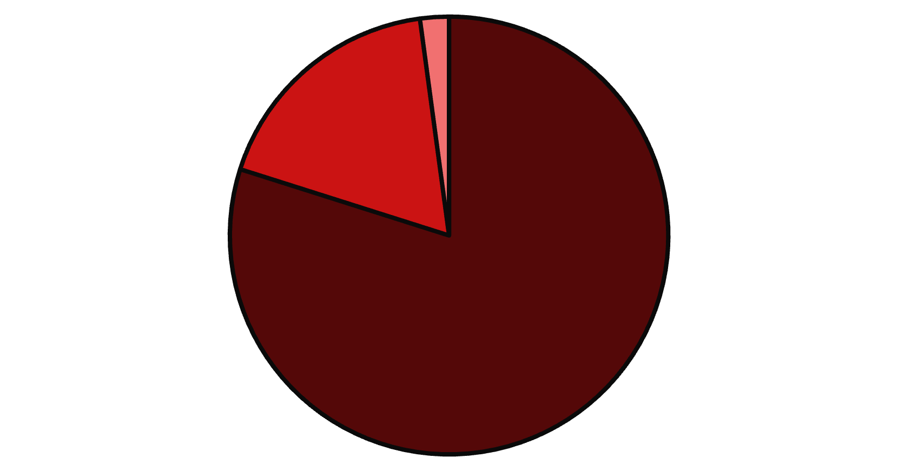
Product Performance & Customer Loyalty
Top-Rated Products
Customer Segmentation
Loyal
Returning
New
Customer review ratings identify top-performing products for marketing emphasis and quality benchmarking.
Loyalty analysis reveals 80% loyal customers, indicating strong retention but opportunity to convert returning customers.

Slide 13
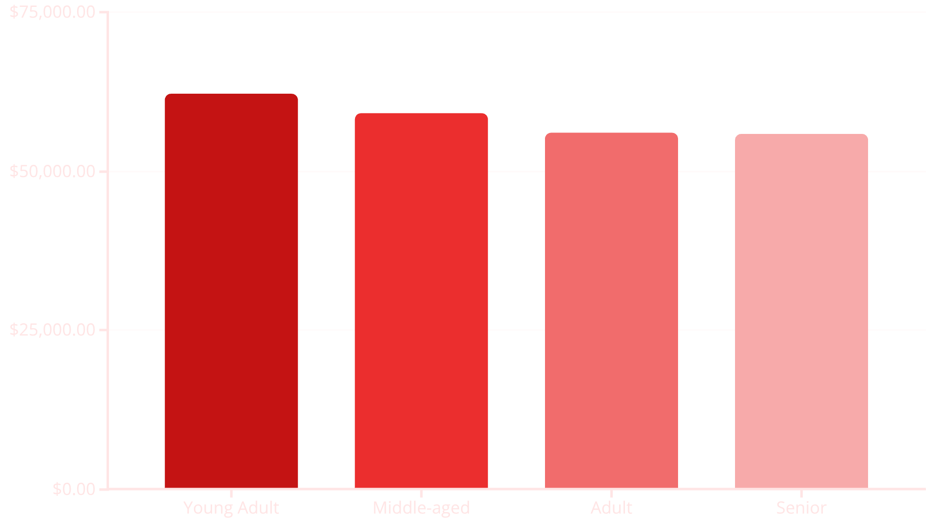
Revenue & Subscription Analysis
$233K
$59.49
$59.87
1,053
Total Revenue
Subscriber Avg Spend
Non-Subscriber Avg
Active Subscribers
Combined revenue from subscribers and non-subscribers across all customer segments.
Average purchase amount per transaction for subscription customers.
Average purchase amount for non-subscription customers, showing minimal difference.
Current subscription customer base representing 27% of total customer population.
Revenue by Age Group
Young adults drive the highest revenue contribution, suggesting this demographic should be prioritized in acquisition and retention campaigns.
Key insight: Despite similar average transaction values, subscriber revenue potential remains undertapped with only 27% market penetration.

Slide 14
Strategic Recommendations
Subscription Growth
Discount Optimization
Shipping Strategy
Launch targeted subscription campaigns focused on frequent and high-value buyers, particularly in the Young Adult segment which shows highest revenue potential. Current 27% penetration offers significant growth opportunity.
Focus promotional activity on product categories with healthy margin profiles. Analysis shows high-spending discount users represent a key conversion segment requiring strategic promotional design.
Promote Express shipping (avg $60.48) to customers with higher order values, creating premium service tier that captures incremental revenue while improving customer experience.
Loyalty Enhancement
Product Marketing
Expand loyalty programs to reduce churn among the 18% returning customer segment and increase lifetime value. Strong 80% loyal base provides foundation for referral programs.
Leverage review ratings to market high-performing products (Gloves, Sandals, Boots) and implement quality improvement initiatives for lower-rated items to enhance overall catalog performance.
Project by Mukesh Gopi Nandh | Email: mukeshudatha7@gmail.com | LinkedIn: mukesh-gopi-nandh | GitHub: Mukeshgn

